Slide 1
The $mart Way: Data-Driven Strategies for Walmart Sales Success

Slide 2

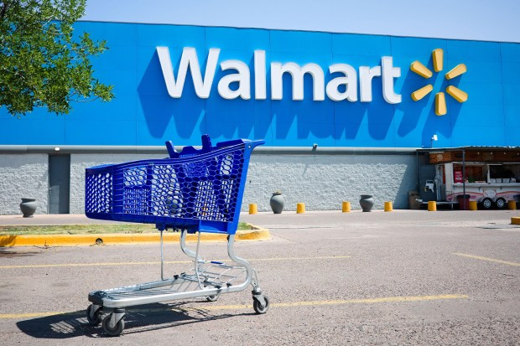
WHY WALMART?
GLOBAL PRESENCE
ONE OF THE BIGGEST RETAIL STORES
DIVERSE SERVICE
FINANCIAL PERFORMANCE
COMPETETIVE STRATEGIES
Notes:
FINANCIAL REPORTS. IT RELEASES

Slide 3
Improve operational efficiency and support strategic decision- making for Walmart in the dynamic retail sector.
Communicate the intention to compute and assess Walmart's overall sales income and profit.
Identify key players and potential growth areas within the data.
Understanding customer groups impacts sales strategies and outcomes.
Assessing the impact of discounts on sales and profitability.
Enhance Walmart's operational efficiency through data-driven insights.
Identifying potential growth areas within Walmart's operations.
•
•
OBJ ECTIVES
•
•

Slide 4
•
Comprehensive information including customer demographics, product specifications, order details, and financial metrics.
•
Offers a rich source for in-depth analysis of various aspects of Walmart's retail operations.
DATA EXPLORATION
Obtain practical insights into Walmart's business practices.
•
•
Address important facets of Walmart's retail strategy.
•
Focus on finding customer segmentation, regional performance, and discount impact.

Slide 5
RESEARCH QUESTIONS
What are the trends in sales that can be identified over time?
What are the shipping mode used for customers in different regions and whether it varies according to the type of customers or the locations they order from.
What is the relationship between discount rates and sales volume. Is there any correlation between them?
Is there any Profitability among different product categories and which ones are less profitable?

Slide 6

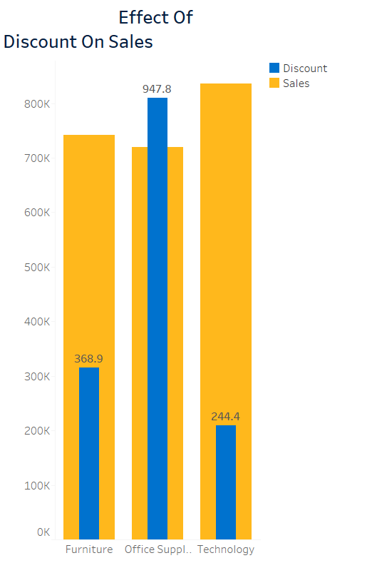
Effect of Discount on Sales
Furniture:
Current situation:The discount given for furniture is 368.9, but the sales are around 800K.
Recommendations: Promotions, Customer education.
Office Supplies:
Current Situation:The discount is significantly higher at 947.8, yet sales remain just above 800K. Recommendations: Pricing strategy, Cross selling.
Technology:
Current Situation:Technology products have the lowest discount (244.4), but sales are almost as high as office supplies.
Recommendations: Product variety, Upselling.

Slide 7
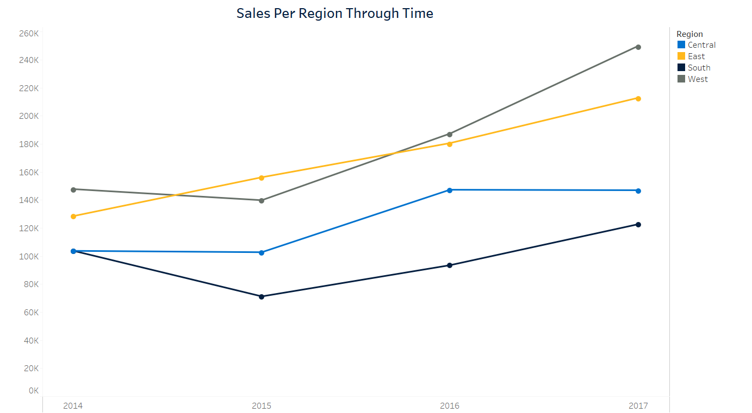
Sales Per Region Through Time
Grey, West: indicates a thriving market with potential for growth.
Yellow East: Steady growth as well although at a slow pace
Black, South region: Initially rising and dipping below 100K.
Blue, Central region: Stable yet flat trend.

Slide 8
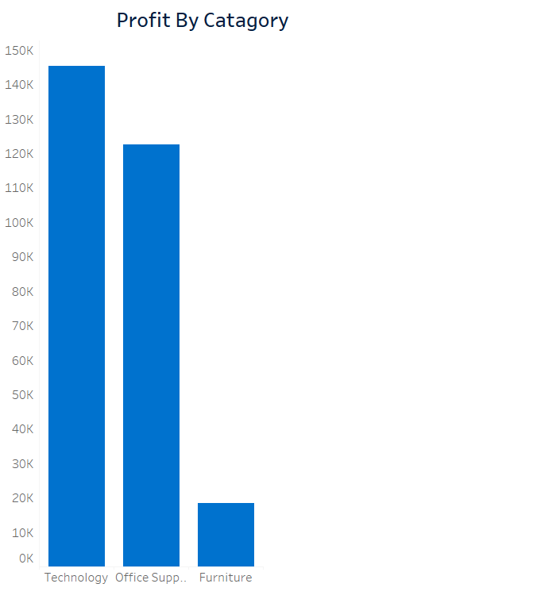
Profit By Category
Technology : Impressive lead
Testament of good marketing strategies
Office supplies:
Room for growth
Furniture: Significantly lower profits

Slide 9
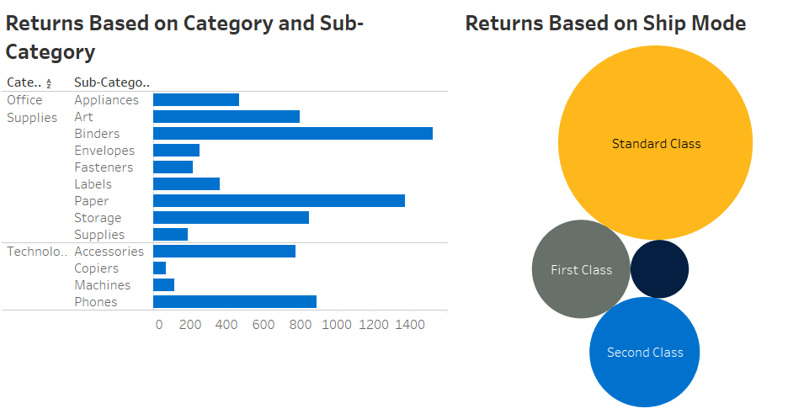
RETURNS
Standard Class has the highest return rate, significantly larger than other modes.
Phones have the highest returns, followed by Machines.Copiers and Accessories have the fewest returns.
providing more incentives for customers to choose shipping options with lower return rates, like discounts on First Class shipping.
Implement a system to collect detailed customer feedback on returns

